Slide 1
APACHE PIG
SIRISHA PAKALAPATI
16161825

Slide 2
Introduction
What is pig?
Provides a simple language for queries and data manipulation, Pig Latin, that is compiled into map-reduce jobs that are run on Hadoop
Pig Latin combines the high-level data manipulation constructs of SQL with the procedural programming of map-reduce some from of adhoc processing and analysis of all of this information is required
2) Why is it important?
some from of adhoc processing and analysis of all of this information is required

Slide 3
Existing solutions
Raw map-reduce
Complex n-stage data flows are not supported; joins and related tasks require workarounds or custom implementations
Resulting code is difficult to reuse and maintain; shifts focus and attention away from data analysis

Slide 4
Language Features
Several options for user-interaction
Built primarily for scan-centric workloads and read-only data analysis
Flexible, fully nested data model
Extensive UDF support

Slide 5
Pig Latin vs. SQL
Pig Latin is procedural (dataflow programming model)
Step-by-step query style is much cleaner and easier to write and follow than trying to wrap everything into a single block of SQL
Lazy evaluation (data not processed prior to STORE command)
Data can be stored at any point during the pipeline
An execution plan can be explicitly defined
No need to rely on the system to choose the desired plan via optimizer hints
Pipeline splits are supported

Slide 6
data models
Supports four basic types
Atom: a simple atomic value (int, long, double, string)
ex: ‘Peter’
Tuple: a sequence of fields that can be any of the data types
ex: (‘Peter’, 14)
Bag: a collection of tuples of potentially varying structures, can contain duplicates
ex: {(‘Peter’), (‘Bob’, (14, 21))}
Map: an associative array, the key must be a char array but the value can be any type

Slide 7
Pig Latin
FOREACH-GENERATE (per-tuple processing)
Iterates over every input tuple in the bag, producing one output each, allowing efficient parallel implementation
(CO)GROUP vs. JOIN
COGROUP takes advantage of nested data structure (combination of GROUP BY and JOIN)
User can choose to go through with cross-product for a join or perform aggregation on the nested bags
LOAD / STORE
Default implementation expects/outputs to tab-delimited plain text file

Slide 8
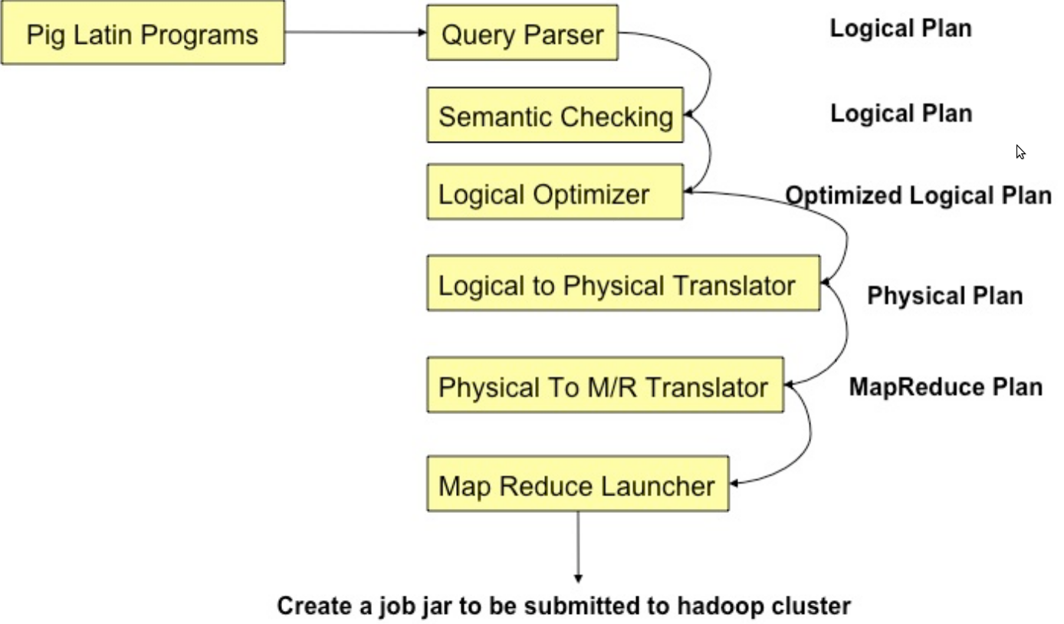
Compilation

Slide 9
Parsing
Type checking with schema
References verifying
Logic plan generating
One-to-one fashion
Independent of execution platform
Limited optimization

Slide 10
Logic Plan
A=LOAD 'file1' AS (x, y, z);
B=LOAD 'file2' AS (t, u, v);
C=FILTER A by y > 0;
D=JOIN C BY x, B BY u;
E=GROUP D BY z;
F=FOREACH E GENERATE group, COUNT(D);
STORE F INTO 'output

Slide 11
Physical Plan
1:1 correspondence with most logical operators
Except for:
DISTINCT
(CO)GROUP
JOIN
ORDER

Slide 12
MapReduce Plan
Determine MapReduce boundaries
GLOBAL REARRANGE
Some operations are done by MapReduce framework
Coalesce other operators into Map & Reduce stages
Generate job jar file

Slide 13
Branching Plans
Read the dataset once and process it in multiple ways
Good
Eliminate the cost to read it multiple times
Bad
Reduce the amount of memory for each stream

Slide 14
Memory management
Java memory management NO low-level control over allocation and deallocation
Intermediate results exceed available memory
Memory manager: a list of Pig bags in a JVM
Spill old bags and perform Garbage collection: when a new bag is added to the list; when the memory runs too low

Slide 15
New strategy (from Pig Manual)
For Pig 0.6.0, the strategy for how Pig decides when to spill bags to disk is changed.
In the past, Pig tried to figure out when an application was getting close to memory limit and then spill at that time.
However, because Java does not include an accurate way to determine when to spill, Pig often ran out of memory.

Slide 16
Streaming
Allows data to be pushed through external executables
Example: A = LOAD 'data'; B = STREAM A THROUGH 'stream.pl -n 5';
Due to asynchronous behavior of external executables, each STREAM operator will create two threads for feeding and consuming data from external executables.

Slide 17
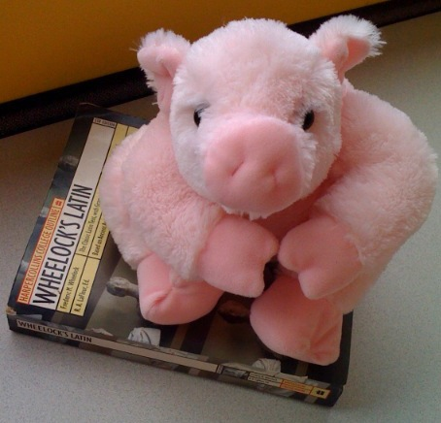
Pig problem
Fragment-replicate; skewed; merge join
User has to know when to use which join
Because pig is a domestic
it will do whatever u
tell to do

Slide 18
Future work
support more nested operators (current only FILTER, ORDER, DISTINCT)
Better optimization order of execution, non-linear
Metadata facility (better knowledge of data)
Parallel job execution (inter-job, currently intra-job)
Column-storage

Slide 19
Application demo

